Slide 1
NSW Premier’s Reading Challenge
7-10 Challenge rules

Slide 2
What is the NSW Premier’s Reading Challenge?
The PRC is a state-wide reading challenge open to every K-10 student in NSW that aims to encourage you to read, to read more, and to read more widely and develop a love of reading for the joy of it!
Part of the challenge involves reading a certain number of books from a set list. These books are read and reviewed by teachers and teacher librarians for their suitability and quality - so every PRC book comes with a recommendation!
There is a huge range of books (almost 11,000) on the PRC booklists - each challenge level contains a huge range of fiction, non-fiction, graphic novels, and picture books.
Students can also read up to 10 personal choice books as part of the Challenge. Personal choice books are books that are not on the NSW PRC booklists, or feature on Challenge booklists you cannot read from.

Slide 3
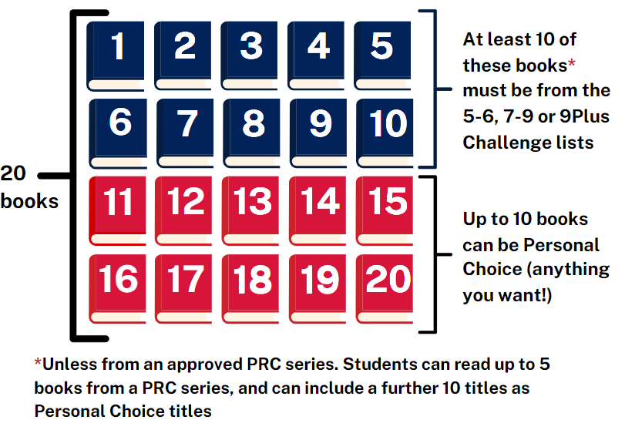
What are the rules of the Challenge?
You must read 20 books and complete your online Student Reading Record by Friday 23 August 2024 (11:59pm) to successfully complete the Challenge.
Your Challenge books can be read from the 5-6 or 7-9 booklists.
At least 10 of your 20 books must be from the PRC booklists.
You can include up to 10 choice books as part of your 20 book total.
Up to 5 books from a PRC series can count towards your PRC list booklist titles. You can read up to 10 more from the same series as Personal Choice books.

Slide 4
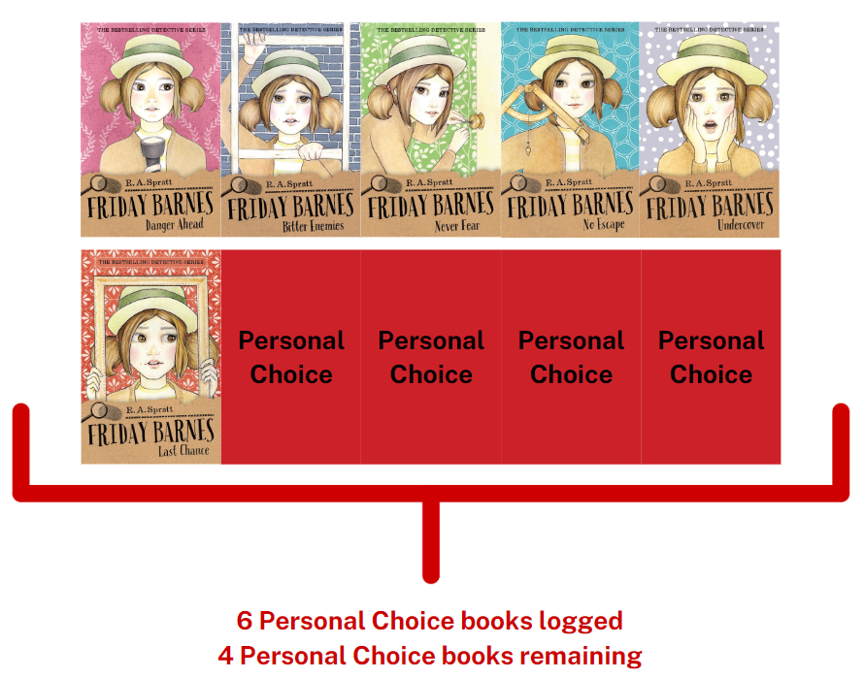
How does the Series rule work?
Let’s look at an example. There are 11 books from the Friday Barnes series on the PRC 7-9 booklist.
If you read all of these books and wanted to add these to your Student Reading Record:
The first 5 would appear as PRC books on your Reading Record
The next 6 Friday Barnes books would be added as Personal Choice books, leaving you with 4 Personal Choice spots on your Reading Record.
Series books can be added onto your reading record in any order.
Series that are 5 books or less do not trigger the series rule.

Slide 5
How do my books need to be read?
You must read books on your own, but someone can help you choose them.
You must read all PRC books in English. You may read Personal Choice books in your home language
If your teacher thinks you need extra help, you can listen to unabridged audio versions of the books as long as you read along.
If you experience difficulties completing the challenge due to circumstances outside your control, talk to your PRC coordinator. Your coordinator can provide school-based supports and adjustments.

Slide 6
PRC Awards
Year of completing the Challenge | Certificate awarded
First year Second year Third Year | Challenge completion certificate
Fourth year | Gold certificate
Fifth year Sixth year | Challenge completion certificate
Seventh year | Platinum certificate
Eighth year Ninth year Tenth year | Challenge completion certificate
Every year from Year 3 - Year 9 OR Seven times between Year 3 and Year 10 | PRC Medal and Challenge completion certificate (Year 9 and 10 only)
Every student who completes their online reading record and has their account validated by their PRC Coordinator will receive a certificate signed by the Premier of NSW.
There are three milestone awards that recognise ongoing reading: the Gold certificate, the Platinum certificate and the PRC Medal.

Slide 7
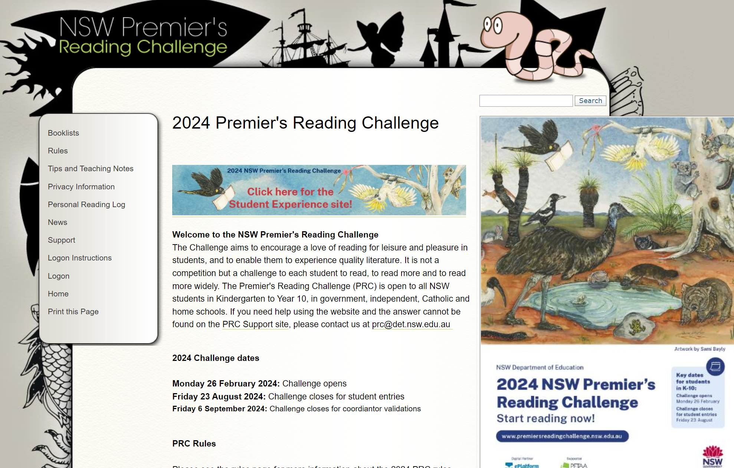
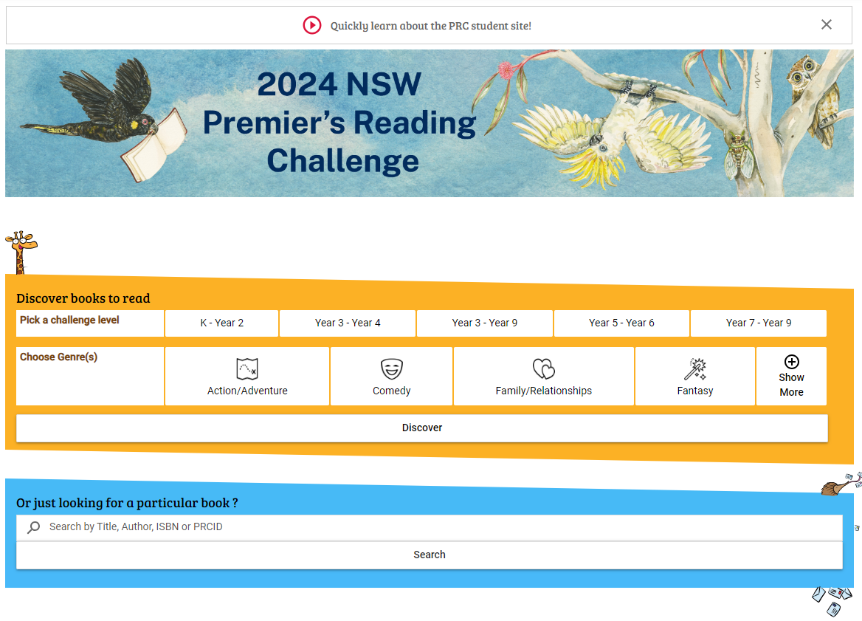
How do I add books to my online reading record?
The Student Experience site is the easiest way to add books to your online reading record.
Click on the banner on the PRC main site to navigate to the Student Experience site

Slide 8
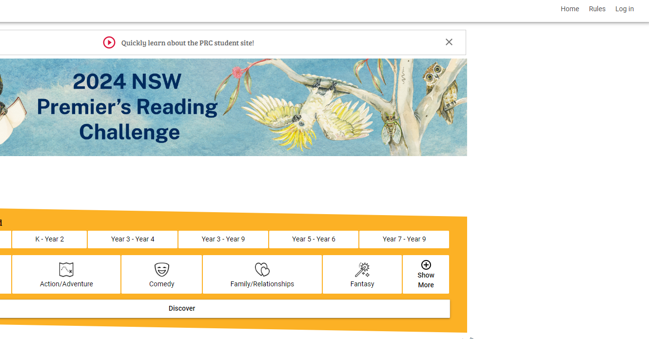
Log into the student experience site
Click the log in option in the top right hand corner, then enter your DoE username and password

Slide 9
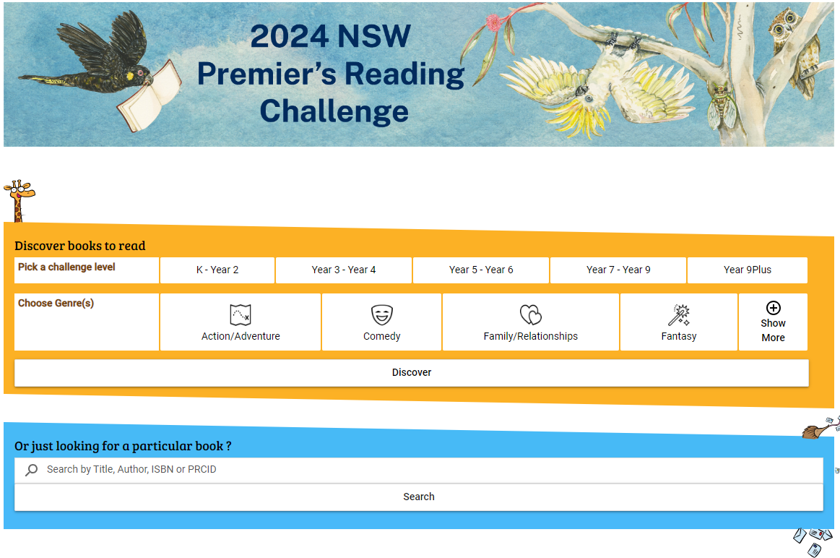
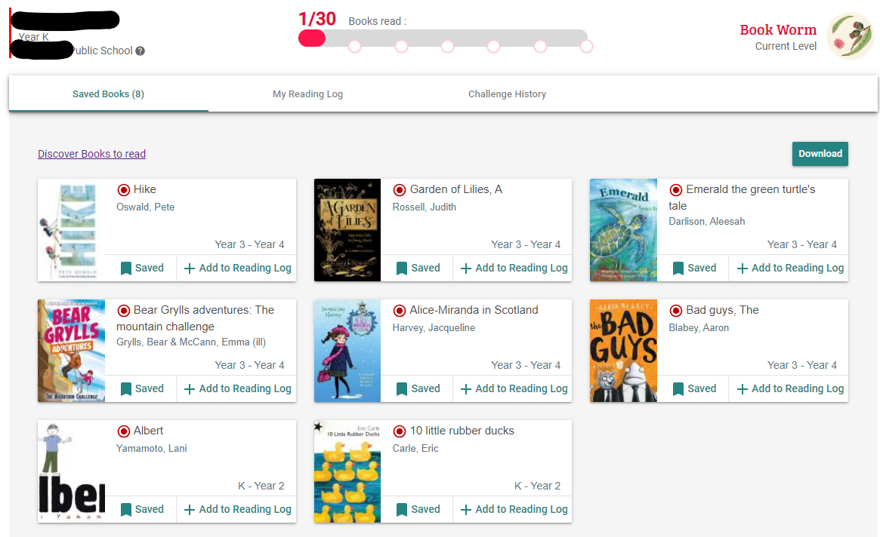
The PRC Student Experience Site
There are two main areas of the Student experience site: The search page and the student profile page.
Search page
Discover PRC books to read or search for specific books.
Student profile page
View your saved books, add books to your reading log and view your Challenge history.

Slide 10
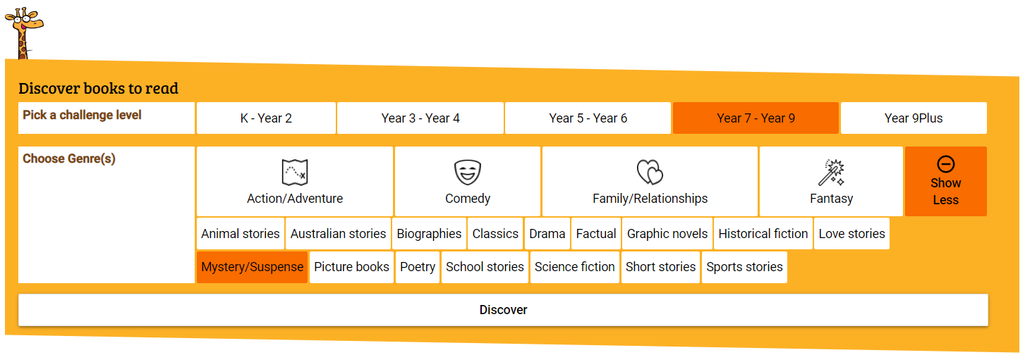
Using the Discover search function
Use the yellow box to search for books on specific Challenge levels and genres that you might like to read. You can select as many Challenge levels and genres as you’d like
Use the bookmark icon to save a book for later, use the plus icon to add a book you have read to your reading record.

Slide 11
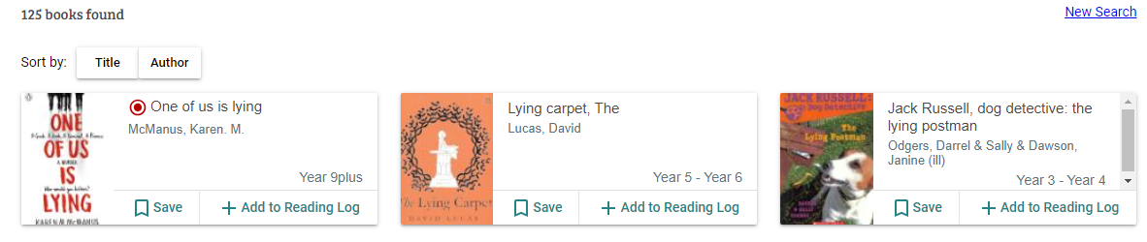
Searching for a specific book (7-10)
Use the blue box to search for a specific book by title or author:
Click the + icon to add the title to your reading record

Slide 12
How to view saved books and add them to your reading record:
1. Click the icon in the top right corner:
The page will open on your saved books tab:
2.. Click on the + icon to add a book to your reading record, or click the saved icon to remove it from your saved book list.

Slide 13
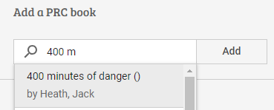
How to add PRC books to your student reading record:
1. Click the icon in the top right corner:
2. Click on My Reading Log
3. Start typing the name of the book under the “Add a PRC book” heading. Click on the name of the book, then click “Add”.

Slide 14
How to add Personal Choice books to your student reading record:
HINT: Always search for your choice book first, in case it has been added to the PRC list! Double check your spelling of the author and title.
1. Click the icon in the top right corner:
2. Click on My Reading Log
3. Type the title and author of your choice book into the fields under the “Add a Personal Choice Book heading,” then click “Add”

Slide 15
Viewing your challenge history
To check your challenge history, click on your student icon, then click the Challenge History tab:
Click on the “click here” URL – this will open your Challenge history in the main PRC site.
It’s important to check your challenge history if you’ve changed schools, as your accounts may need to be merged by the PRC team.

Slide 16
How to use the PRC Student Experience site
This video provides a brief overview of how to use the PRC Student Experience site.

Slide 17
Amazing PRC titles in your library: 7-9 booklist
Use this slide to include book covers and brief synopsises of PRC titles in your library. Delete the boxes or ensure they are fully covered by the book cover image.
Include a brief synopsis here
Include a brief synopsis here
Include a brief synopsis here
Include a brief synopsis here
Include a brief synopsis here
Include a brief synopsis here
Include a brief synopsis here
Include a brief synopsis here
Include a brief synopsis here
Include a brief synopsis here
Include a brief synopsis here
Include a brief synopsis here

Slide 18
Amazing PRC titles in your library: 9Plus booklist
Use this slide to include book covers and brief synopsises of PRC titles in your library. Delete the boxes or ensure they are fully covered by the book cover image.
Include a brief synopsis here
Include a brief synopsis here
Include a brief synopsis here
Include a brief synopsis here
Include a brief synopsis here
Include a brief synopsis here
Include a brief synopsis here
Include a brief synopsis here
Include a brief synopsis here
Include a brief synopsis here
Include a brief synopsis here
Include a brief synopsis here

